Slide 1
CSS - tools (Day 3)
Viktoras Lava www.viktoraslava.lt

Slide 2
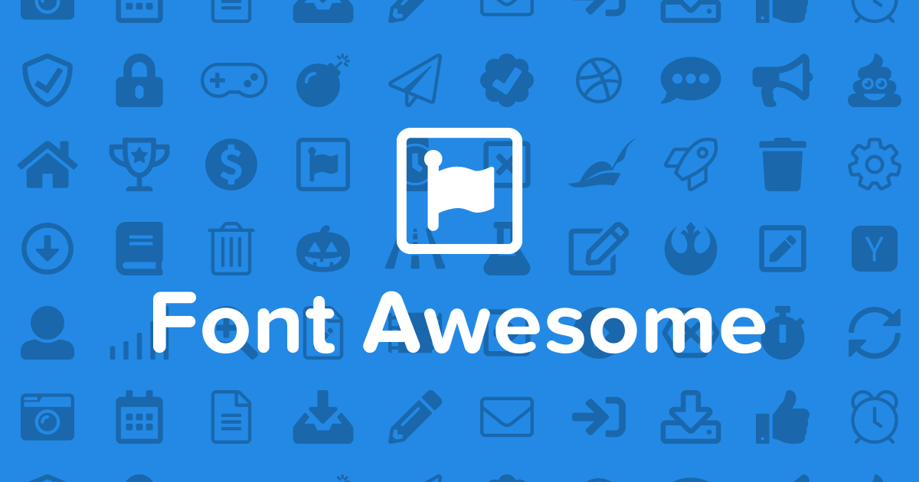
Tools
Today we will talk about CSS tools that can speed up your web development.
We already talked about a few ones:
Google Fonts
Font Awesome
However, there are more that you have to know.

Slide 3
Tool classification
I would classify CSS tools into three main categories:
generators
libraries
frameworks
Let’s talk about these categories and what they mean.

Slide 4
What is a generator?
colorzilla.com (gradient generator)
cssgradient.io (gradient generator)
css3maker.com (generator)
type-scale.com (typography)
gridlover.net/try (typography)
webcode.tools/css-generator/
CSS generator is a tool that helps you to create numerous graphic styles and immediately get their code without knowing complex CSS.
Generator can also be used to play around with complex CSS rules.

Slide 5

What is a library?
CSS library is a very specific tool that usually does only one particular thing.
For example, Google Fonts let’s you to add fonts and Font Awesome let’s you to add icon fonts to your document.
They both do a very specific task, so they can be called a CSS library.

Slide 6
Useful libraries
Google Fonts
Font Awesome
Reset.css
Normalize.css
Animate.css
Hover.css
Loaders.css
CSSshake

Slide 7
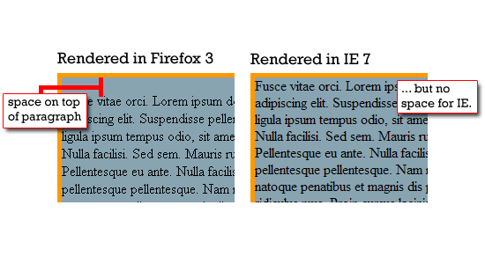
What is reset.css?
It’s a simple CSS library to reset default user agent styles for your website.
It let’s to achieve consistent line-heights, margins and font-sizes across all web browsers.

Slide 8
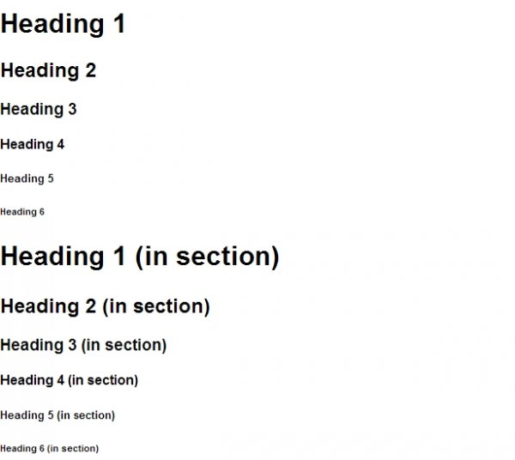
What is normalize.css?
It’s a similar library to a reset.css, however it normalizes default user agent styles for your website.
Example - normalize.css vs reset.css

Slide 9
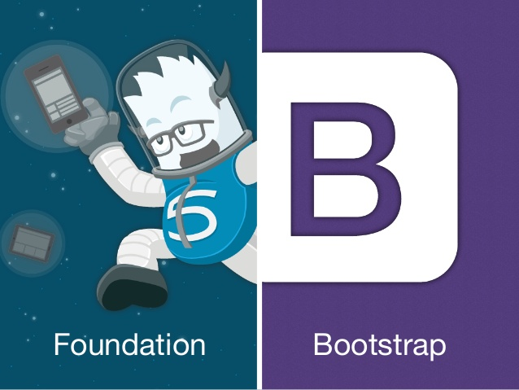
What is a framework?
CSS frameworks:
Bootstrap (websites)
Foundation (website)
Framework7 (web/mobile applications )
CSS libraries:
CSS framework is a prepared software that is meant to allow easier web development.
They usually include these tools:
reset.css or normalize.css
Grid
Typography
Icons
UI elements
CSS helpers

Slide 10
Popular CSS frameworks
For websites:
Bootstrap
Foundation
PureCSS
For mobile applications:
Ionic
Framework7
Onsen

Slide 11
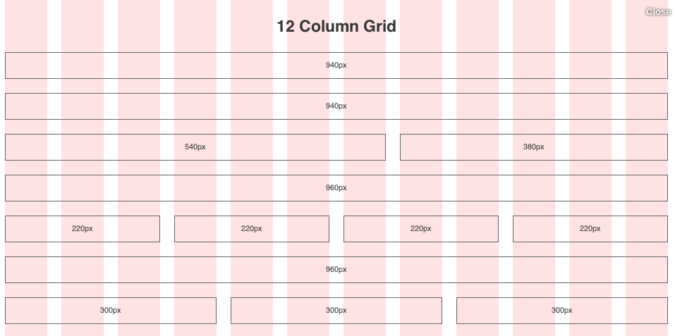
What is a GRID?

Slide 12
Questions?

